Slide 1


Object oriented programming
MEC Academy

Slide 2
Agenda
What is oop
Procedural programming
What is the class
implementation
Dependencies
&
Issues / Risks
Schedule (High Level)
Completed Activities
Timeline
Action
Items
Change Requests

Slide 3
What is OOP ?
object-oriented programming: is a programming paradigm based on the concept of object
A programming paradigm : is a style of programming , a way of thinking about software construction
programming paradigm : does not refer to a specific language but rather to a way to build a program or a methodology to apply
some programming languages allow the programmer apply more than one paradigm

Slide 4
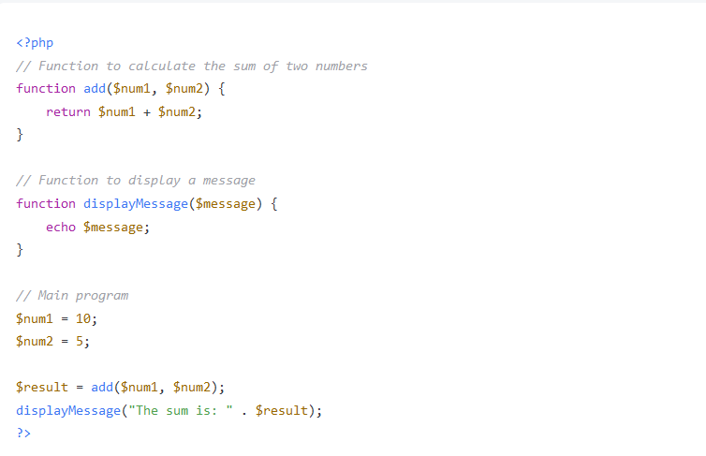
Procedural Programming
Procedural programming (PP) :
also known as inline programming takes a top-down approach. It is about writing a list of instructions to tell the computer what to do step by step. It relies on procedures or routines

Slide 5

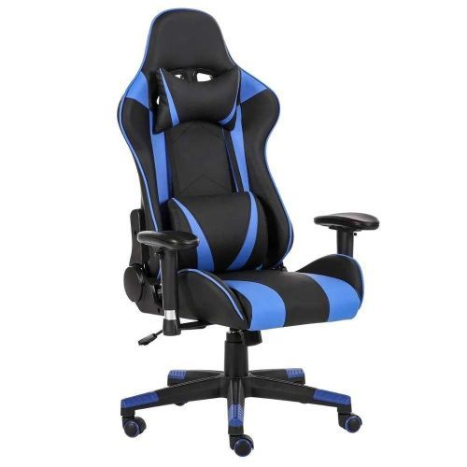
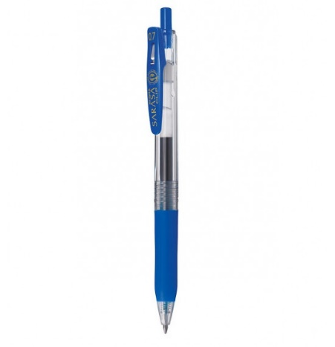



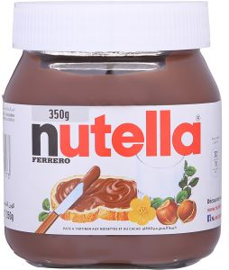
object-oriented programming: is a programming paradigm based on the concept of object

Slide 6
faculty
Student
Teacher
Courses
Worker
Class

Slide 7
Super Market
product
customer
worker
Salesman
cashier

Slide 8
Object comprised of
Object
Data
Operation ( )

Slide 9
Product
Product_name
Product_code
Expire
Price
Discount
Modify_price()
Set_ProduceName()
Set_productName()
Get_price()
Set_discount()

Slide 10
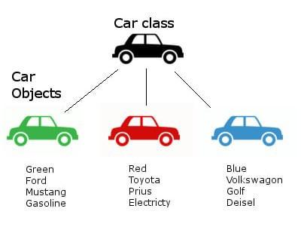
What is Class ?

Slide 11
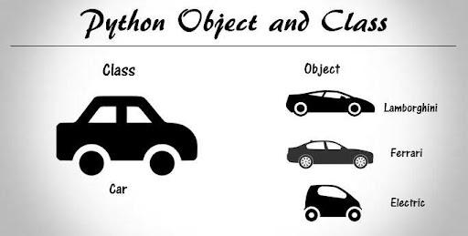

Slide 12
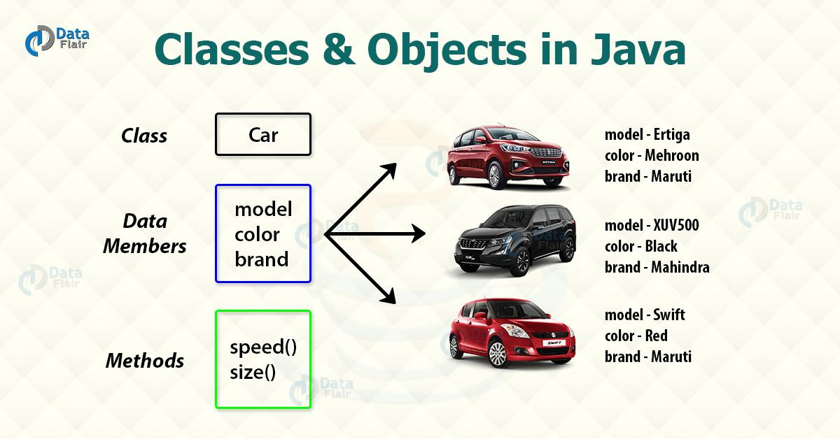

Slide 13



Man
Mo Salah
محمد بن احمد

Slide 14
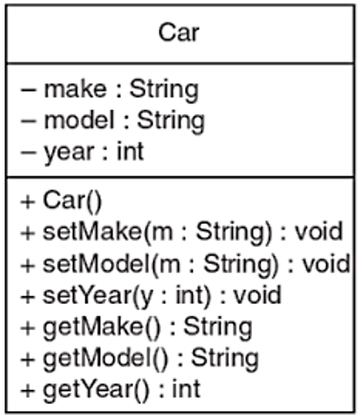
UML Digram

Slide 15
THANKS
Any questions?

